Slide 1


Team-6 Project Presentation
Raja Ruthvik Shetty
Phani Satya Sai Pamarthi
Dhanushi Panga
Rithvik Madhavaram
Kashyap Kandibanda
Mano Harsha Sappa
Website Link: https://mason.gmu.edu/~rshetty4/

Slide 2
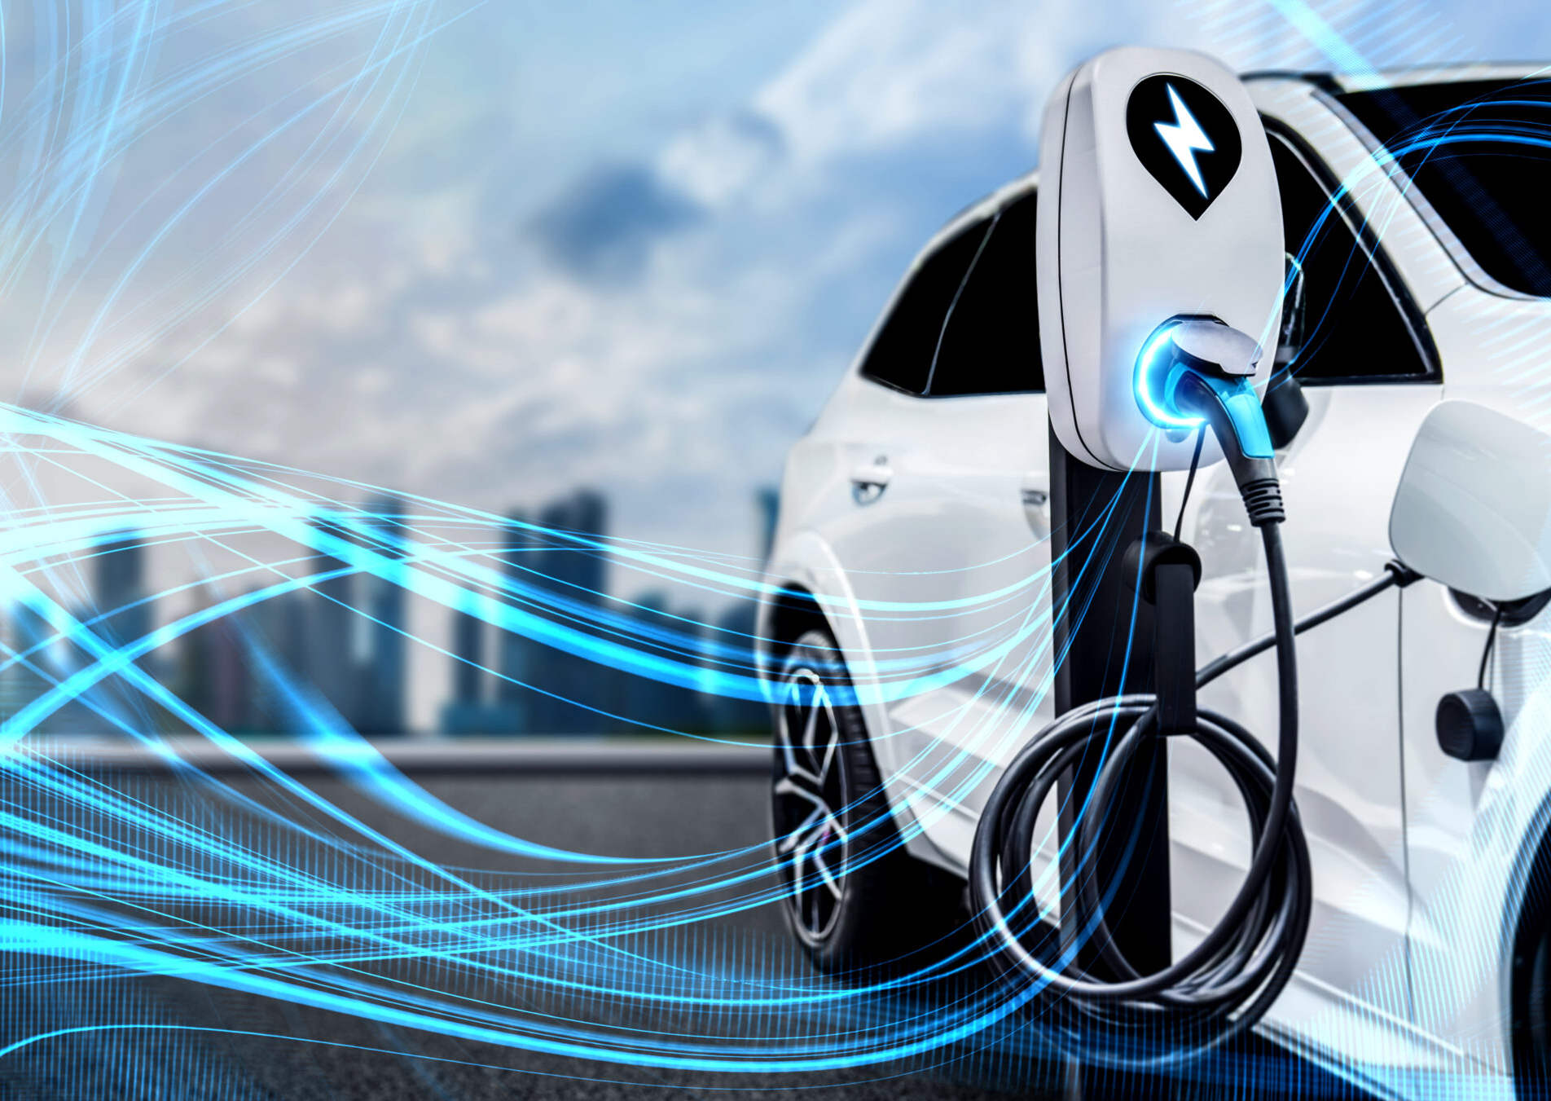
Electrifying the Road: Understanding Adoption Patterns and Policy Impacts on EV Growth

Slide 3
Presenter: Raja Ruthvik Shetty
https://mason.gmu.edu/~rshetty4/

Slide 4
INTRODUCTION
Introduction
Acknowledge
Objectives
Related Work
Project Timeline
Datasets
Methods
Experimental Results & Analysis
Key Findings & Insights
Conclusions
EVs are central to reducing transportation emissions, which account for 29% of U.S. greenhouse gases.
Adoption varies widely across regions, with states like California leading and others lagging due to infrastructure, awareness, and economic disparities.
National trends are insufficient; localized analysis is essential to understand what drives or hinders EV adoption.
This study uses machine learning (regression, clustering, PCA) on EV registration data to uncover key adoption patterns.
Electric range is used as a proxy for charging infrastructure confidence in the absence of direct infrastructure data.
Socioeconomic factors and policies (e.g., income, education, incentives) are recognized as vital, though not fully modeled in this study.
The goal is to inform targeted policies and investments that support inclusive and effective EV adoption nationwide.

Slide 5
OBJECTIVES
Introduction
Acknowledge
Objectives
Related Work
Project Timeline
Datasets
Methods
Experimental Results & Analysis
Key Findings & Insights
Conclusions
To determine the impact of vehicle-specific characteristics (e.g., electric range, fuel type, model year) on EV adoption using linear regression and random forest models.
To apply K-Means clustering and PCA to identify natural groupings of EVs based on technical attributes that align with adoption patterns or policy-relevant segments.
To analyse the relationship between electric range and EV adoption trends, using range as a proxy for charging infrastructure confidence.
To highlight the importance of incorporating demographic and policy-related factors (e.g., income, education, incentives) into future studies to enhance understanding of regional EV adoption patterns.

Slide 6
Presenter: Phani Satya Sai Pamarthi
https://mason.gmu.edu/~rshetty4/

Slide 7
RELATED WORK
Introduction
Acknowledge
Objectives
Related Work
Project Timeline
Datasets
Methods
Experimental Results & Analysis
Key Findings & Insights
Conclusions
Gallagher, K. S., & Muehlegger, E. (2011)
Theme: Social Influence and Consumer Behavior
Funke, S. Á., Gnann, T., & Plötz, P. (2019)
Theme: Technology Advancement and Charging Infrastructure Key Insight: Technical advancements, especially in battery range and charging speed, significantly improve user satisfaction and increase the likelihood of EV adoption across user segments.
Sierzchula, W., Bakker, S., Maat, K., & van Wee, B. (2014).
Theme: Financial Incentives and EV Uptake Key Insight: Government policies particularly purchase incentives and investment in charging infrastructure are among the strongest predictors of national EV market share.
Hardman, S., Shiu, E., & Steinberger Wilckens, R. (2016)
Theme: Long-Term Adoption and Financial Incentives Key Insight: While short-term incentives drive initial EV purchases, long-term adoption depends on continued benefits such as fuel savings, maintenance cost reductions, and consistent policy support.
Key Insight: Social dynamics, including peer influence and identity signaling, play a critical role in shaping consumer interest and willingness to adopt EVs, beyond technical or financial factors.
Axsen, J., & Kurani, K. S. (2013)
Theme: Financial Incentives Key Insight: Financial incentives such as tax credits and rebates significantly increase EV adoption, especially when they are visible, immediate, and easily accessible to consumers.

Slide 8
PROJECT TIMELINE
Introduction
Acknowledge
Objectives
Related Work
Project Timeline
Datasets
Methods
Experimental Results & Analysis
Key Findings & Insights
Conclusions
Phase 3: Model Development Regression, clustering, trend analysis
Phase 4: Policy Evaluation Assessing the impact of incentives and infrastructure
Phase 5: Interpretation & Recommendations Drawing insights and policy recommendations
Phase 6: Report & Presentation Documentation and final report preparation
Phase 1: Data Collection & Preprocessing Data acquisition, cleaning, handling missing values
Phase 2: Exploratory Data Analysis (EDA)Descriptive statistics, visualizations, correlation analysis

Slide 9
Presenter: Dhanushi Panga
https://mason.gmu.edu/~rshetty4/

Slide 10
DATASET
Introduction
Acknowledge
Objectives
Related Work
Project Timeline
Datasets
Methods
Experimental Results & Analysis
Key Findings & Insights
Conclusions
Data sourced from DATA.GOV
Focus on patterns of EV adoption
Features include model, model year, electric vehicle type, electric range, and eligibility for Clean Alternative Fuel car (CAFV) incentives county, postal code, and vehicle position coordinates.
The dataset contains 223995 rows and 17 columns, providing a comprehensive overview of bridge conditions.

Slide 11
Presenter: Rithvik Madhavaram
https://mason.gmu.edu/~rshetty4/

Slide 12
METHODS
Introduction
Acknowledge
Objectives
Related Work
Project Timeline
Datasets
Methods
Experimental Results & Analysis
Key Findings & Insights
Conclusions
Data Preparation
Exploratory Analysis
Modeling
Trained Random Forest for predictive analysis.
Evaluation & Output
Random Forest achieved R² of 0.89.
Collected and cleaned EV registration data
Analysed correlations between key features.
Engineered features for improved model performance
Scaled data for consistent modeling.
Applied clustering to identify EV segments.
Used PCA for data separability validation.
Evaluated Linear Regression and Decision Trees.
Applied K-Means clustering for segmentation.
Evaluated models using MSE and RMSE.
Provided insights for EV adoption strategies.

Slide 13
Presenter: Kashyap Kandibanda
https://mason.gmu.edu/~rshetty4/

Slide 14
EXPERIMENTAL RESULTS
Introduction
Acknowledge
Objectives
Related Work
Project Timeline
Datasets
Methods
Experimental Results & Analysis
Key Findings & Insights
Conclusions
Random Forest (Regressor):
Precision: 99.40%
Linear Regression:
Decision Tree:
RMSE: 0.543
KMeans Clustering:
Low Adoption Area: 46,599
Random Forest (Balanced):
F1 Score: 90.83%
Accuracy: 91.7%
Accuracy: 71%
R²: 0.9964
Isolation Forest:
Accuracy: 75%
R² Score: 0.9966
Mean Squared Error: 24.91
Moderate Adoption Area: 130,552
High Adoption Area: 46,826

Slide 15
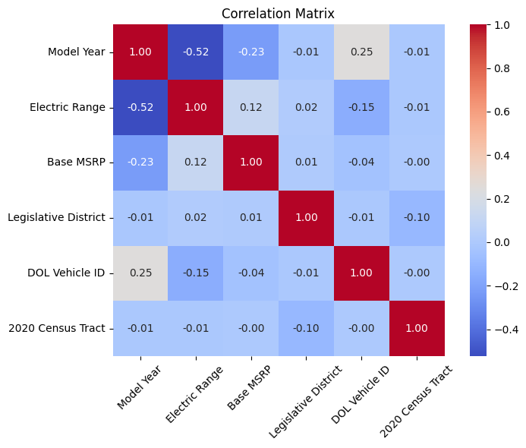
KEY FINDINGS & INSIGHTS
Introduction
Acknowledge
Objectives
Related Work
Project Timeline
Datasets
Methods
Experimental Results & Analysis
Key Findings & Insights
Conclusions
Model Year & Electric Range: Moderately negative correlation (-0.52). Newer models don’t always have longer ranges.
Base MSRP & Range: Weak positive link (0.12), higher-priced EVs may have slightly better range.
Minimal correlation with geographic factors like District and Census Tract — limited regional influence.

Slide 16
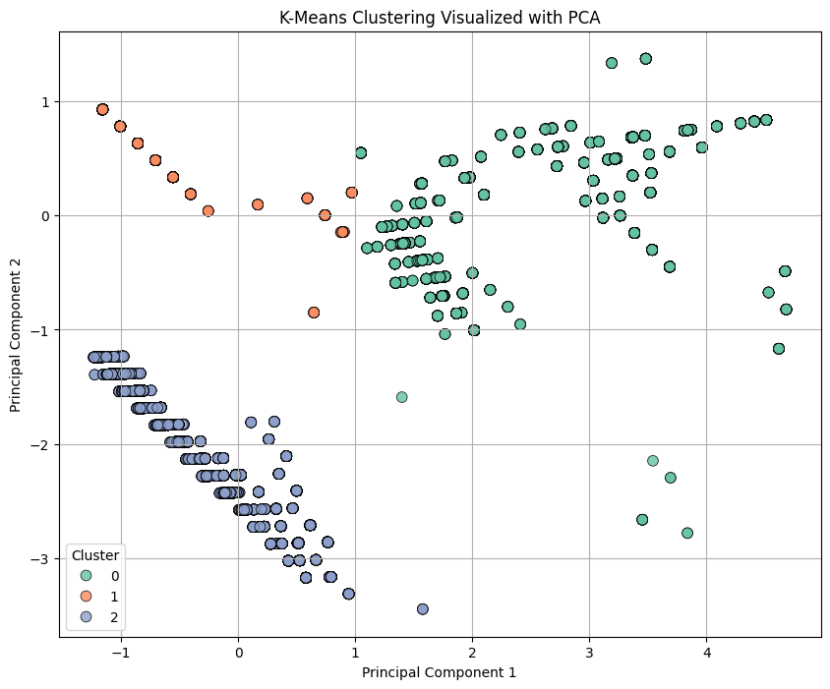
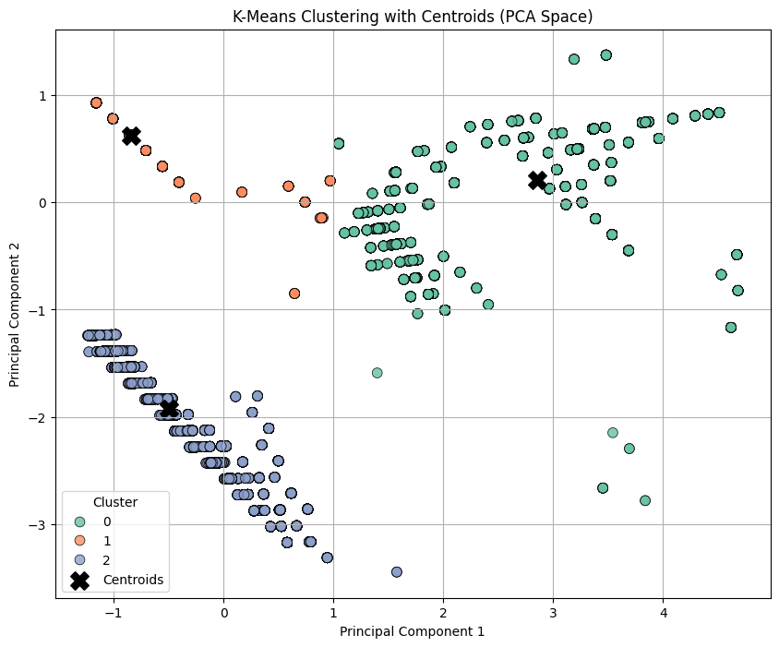
KEY FINDINGS & INSIGHTS
Introduction
Acknowledge
Objectives
Related Work
Project Timeline
Datasets
Methods
Experimental Results & Analysis
Key Findings & Insights
Conclusions

Slide 17
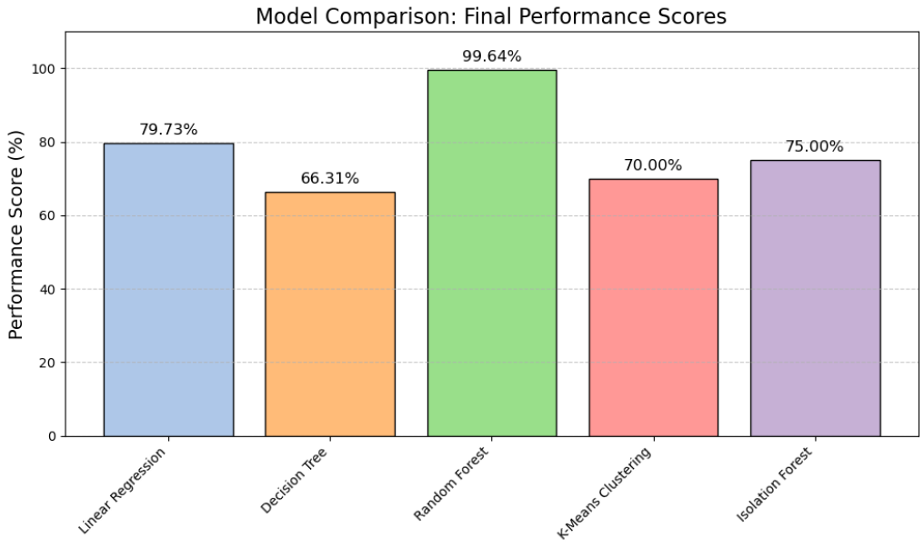
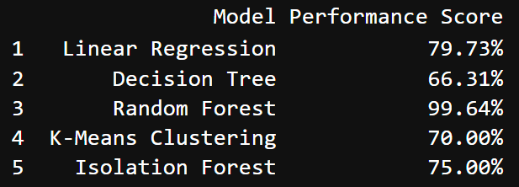
KEY FINDINGS & INSIGHTS
Introduction
Acknowledge
Objectives
Related Work
Project Timeline
Datasets
Methods
Experimental Results & Analysis
Key Findings & Insights
Conclusions

Slide 18
Presenter: Mano Harsha Sappa
https://mason.gmu.edu/~rshetty4/

Slide 19
CONCLUSIONS
Introduction
Acknowledge
Objectives
Related Work
Project Timeline
Datasets
Methods
Experimental Results & Analysis
Key Findings & Insights
Conclusions Future works
Insights from clustering can help guide marketing and infrastructure investment strategies for EV adoption.
Clustering identified three EV segments, from older hybrids to modern electric vehicles.
Machine learning techniques (regression, clustering, PCA) were applied to transportation data, offering a repeatable pipeline for future research and policy evaluation.
Applied Linear Regression, Decision Tree, Random Forest , K-Means Clustering and Isolation Forest
Random Forest Regression showed strong predictive accuracy (R² = 0.89), highlighting the importance of electric range and newer model years.
Clustering identified three EV segments, from older hybrids to modern electric vehicles.

Slide 20
FUTURE WORKS
Introduction
Acknowledge
Objectives
Related Work
Project Timeline
Datasets
Methods
Experimental Results & Analysis
Key Findings & Insights
Conclusions Future works
The study used machine learning to analyse electric vehicle (EV) adoption trends, focusing on factors like electric range, model year, and vehicle type.
Include state and local policy variables (e.g., incentives, rebates, infrastructure) to assess their statistical impact on EV registrations.
Machine learning techniques (regression, clustering, PCA) were applied to transportation data, offering a repeatable pipeline for future research and policy evaluation.
Insights from clustering can help guide marketing and infrastructure investment strategies for EV adoption.
Expand the dataset to national or multi-state levels to enhance generalizability and enable regional.
Incorporate diverse contextual factors and complex models to reflect the multifaceted nature of EV adoption.

Slide 21
ACKNOWLEDGEMENTS
Introduction
Acknowledge
Objectives
Related Work
Project Timeline
Datasets
Methods
Experimental Results & Analysis
Key Findings & Insights
Conclusions
Kashyap Kandibanda Department of Data Analytics Engineering George Mason University, Fairfax, VA 22030 Email: kkandiba@gmu.edu
Raja Ruthvik Shetty Department of Data Analytics Engineering George Mason University, Fairfax, VA 22030 Email: rshetty4@gmu.edu
Phani Satya Sai Pamarthi Department of Data Analytics Engineering George Mason University, Fairfax, VA 22030 Email: ppamarth@gmu.edu
Dhanushi Panga Department of Data Analytics Engineering George Mason University, Fairfax, VA 22030 Email: dpanga@gmu.edu
Rithvik Madhavaram Department of Data Analytics Engineering George Mason University, Fairfax, VA 22030 Email: rmadhav2@gmu.edu
Mano Harsha Sappa Department of Data Analytics Engineering George Mason University, Fairfax, VA 22030 Email: msappa@gmu.edu

Slide 22
ACKNOWLEDGEMENTS
Introduction
Acknowledge
Objectives
Related Work
Project Timeline
Datasets
Methods
Experimental Results & Analysis
Key Findings & Insights
Conclusions
Special thanks to Professor Dr. Can Nguyen for his expert guidance throughout the project.
Grateful to GTA Vishay Paka and Sarika Amudalapalli for their timely responses and consistent support.
Appreciation to George Mason University for providing the research infrastructure and tools.
Successful execution made possible through excellent teamwork and collaboration.

Slide 23

THANK YOU

